Slide 1

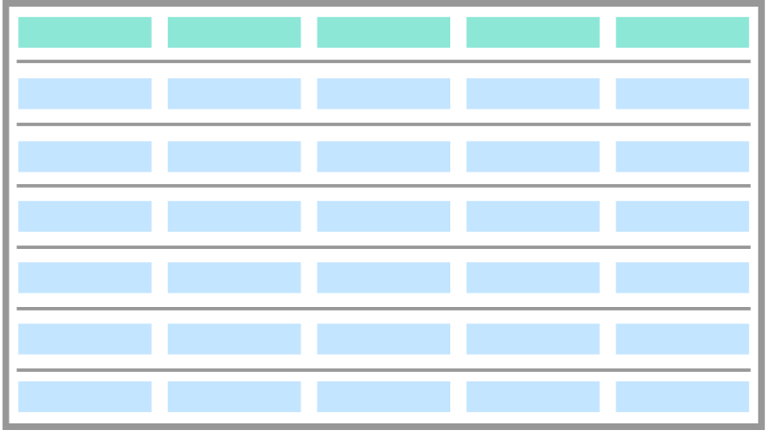

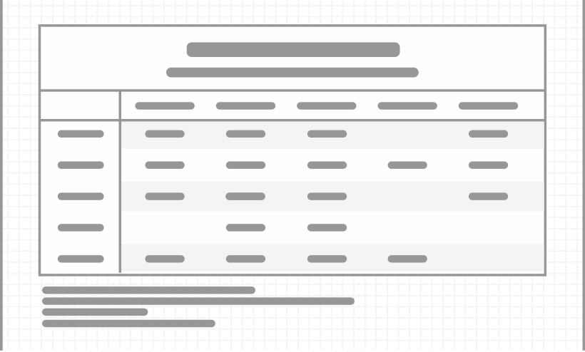



An Introduction to the gt Package
table data
gt object
gt table
rich-iannone
@riannone
rich@rstudio.com

Slide 2
The Typical Workflow for Making Tables with gt
An Introduction to the gt Package
table data
gt object
gt table
The gt package lets us create display tables with a declarative interface, allowing us to fine-tune the final appearance.
Integrate the tables in R Markdown docs and Shiny applications.
Program with gt to make tables as output objects in packages.
Put your data to a form that’s reasonably close to the expected form of the display table.
Use dplyr and tidyr and other great Tidyverse 📦s.

Slide 3
The Typical Workflow for Making Tables with gt
①
②
③
table data
gt object
gt table
Put your data in a form that’s reasonably close to the expected form of the display table.
Use dplyr and tidyr and other great Tidyverse 📦s.
Add table components, group rows together, add spanner labels, footnotes, format cells, add styles…
Output the table to HTML, save an image. RTF and LaTeX output is possible as well.
Use gt’s functions to build. Preview in RStudio.
Use tables in Shiny apps, reports, packages, etc.

Slide 4
The Typical Workflow for Making Tables with gt
①
②
③
table data
gt object
gt table
Put your data in a form that’s reasonably close to the expected form of the display table.
Add table components, group rows together, add spanner labels, footnotes, format cells, add styles…
Use dplyr and tidyr and other great Tidyverse 📦s.
Use gt’s functions to build. Preview in RStudio.
Output the table to HTML, save an image. RTF and LaTeX output is possible as well.
Use tables in Shiny apps, reports, packages, etc.

Slide 5
Categorizing the Useful Features of a Table
The Typical Workflow for Making Tables with gt
①
②
③
table data
gt object
gt table
Put your data in a form that’s reasonably close to the expected form of the display table.
Add table components, group rows together, add spanner labels, footnotes, format cells, add styles…
Output the table to HTML, save an image. RTF and LaTeX output is possible as well.
Use dplyr and tidyr and other great Tidyverse 📦s.
Use gt’s functions to build. Preview in RStudio.
Use tables in Shiny apps, reports, packages, etc.

Slide 6
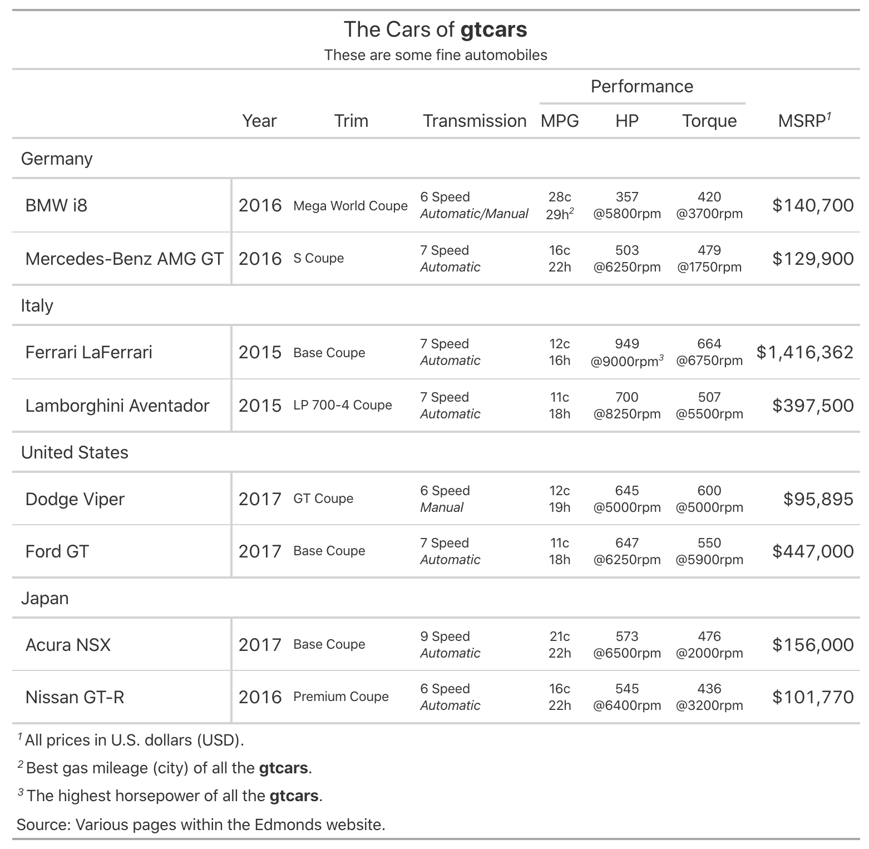
the gt package
Lets you build display tables with easy-to-use functions
Table outputs can be HTML, LaTeX, and RTF
Available on GitHub
The Typical Workflow for Making Tables with gt
Categorizing the Useful Features of a Table
table header
with a title and a subtitle
column labels
along with column grouping
row labels
data formatting
along with row grouping
need to transform raw data for presentation
footnotes
a source note
are in the right order

Slide 7
Categorizing the Useful Features of a Table
The ordering of footnotes must always be correct.
1
2
And it’s no fun doing this manually.
3
1
2
3
footnotes
are in the right order

Slide 8
Categorizing the Useful Features of a Table
1
To do this right, a system needs to index the locations left-to-right then
top-to-bottom.
2
3
4
This system also must be smart about the formatting of the footnote marks.
5
6
7
8
9
10
11
13
14
15
16
17
18
19
20
21
22
23
24
25
26
27
28
29
30
31
32
33
34
35
36
37
38
39
40
41
42
43
44
45
46
47
48
49
50
51
52
53
54
55
56
57
58
59
60
61
62
63
64
65
66
67
68
69
70
71
72
73
74
75
76
77
78
79
80

Slide 9
The gt Package Formalizes the Parts of a Table

Slide 10
The Structural Parts of a Table
This is the most basic form of a gt table:
stub
head
column
label
stubhead label
column
label
column
label
column labels
cell
row label
cell
cell
cell
row label
cell
cell
stub
table body
cell
row label
cell
cell
cell
row label
cell
cell

Slide 11
The Structural Parts of a Table
stub
head
stubhead label
column
label
column
label
column
label
title
column labels
subtitle
row group
row group label
row label
cell
cell
cell
row label
cell
cell
cell
stub
table body
row label
cell
cell
cell
summary label
row label
summary cell
cell
cell
cell
summary cell
summary cell
A table stub is not always needed but it can be useful.
Rows can be grouped, and they can have labels.
Summary rows can be added to groups (or, we can have a grand summary).

Slide 12
The Structural Parts of a Table
table
header
title
subtitle
stub
head
stubhead label
column
label
column
label
column
label
column labels
row group
row group label
row label
cell
cell
cell
stub
table body
row label
cell
cell
cell
footnotes
summary label
summary cell
summary cell
summary cell
source notes
A table header is a great place to add a title and a subtitle.

Slide 13
The Structural Parts of a Table
table
header
title
subtitle
stub
head
stubhead label
column
label
column
label
column
label
column labels
row group
row group label
row label
cell
cell
cell
stub
table body
row label
cell
cell
cell
summary label
summary cell
summary cell
summary cell
footnotes
table
footer
source notes
Footnotes and source notes serve as useful annotations.

Slide 14
The Structural Parts of a Table
table
header
title
Spanner column labels can be used to group columns together.
subtitle
stub
head
spanner column label
spanner column labels
stubhead label
column
label
column
label
column
label
column labels
row group
row group label
row label
cell
cell
cell
stub
table body
row label
cell
cell
cell
summary label
summary cell
summary cell
summary cell
footnotes
table
footer
source notes

Slide 15
The Structural Parts of a Table
table
header
table
header
title
subtitle
stub
head
spanner column label
spanner column labels
stubhead label
column
label
column
label
column
label
column labels
row group
row group label
row label
cell
cell
cell
stub
table body
row label
cell
cell
cell
summary label
summary cell
summary cell
summary cell
footnotes
table
footer
source notes

Slide 16
Let’s Learn How to Use gt

Slide 17



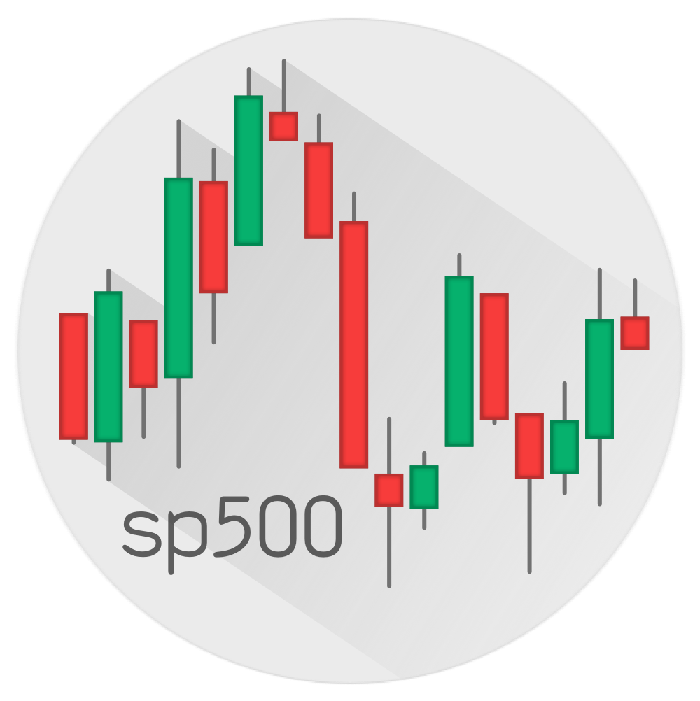


Datasets in gt
The gt package comes with six example datasets.
They are of various sizes and subject matter. There are some nice examples available at:
countrypops
sza
gtcars
gt.rstudio.com/articles/gt-datasets
Let’s take a look at some examples with exibble: a dataset that’s great for small examples.
sp500
pizzaplace
exibble

Slide 18
Datasets in gt
The gt package comes with six example datasets.
They are of various sizes and subject matter. There are some nice examples available at:
countrypops
sza
gtcars
12,470 × 5
816 × 4
47 × 15
gt.rstudio.com/articles/gt-datasets
Let’s take a look at some examples with exibble: a dataset that’s great for small examples.
sp500
pizzaplace
exibble
16,607 × 7
49,574 × 7
8 × 9

Slide 19
The First Function You Need to Know
Datasets in gt
The gt package comes with six example datasets.
They are of various sizes and subject matter. There are some nice examples available at:
gt.rstudio.com/articles/gt-datasets
Let’s take a look at some examples with exibble: a dataset that’s great for small examples.
exibble
8 × 9

Slide 20
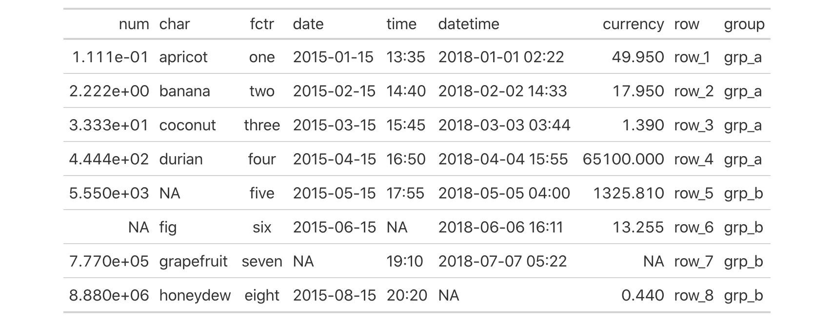
Datasets in gt
Work with Table Components, Add Style
The First Function You Need to Know
Create Table
gt()
CODE
exibble %>% gt()
TABLE

Slide 21
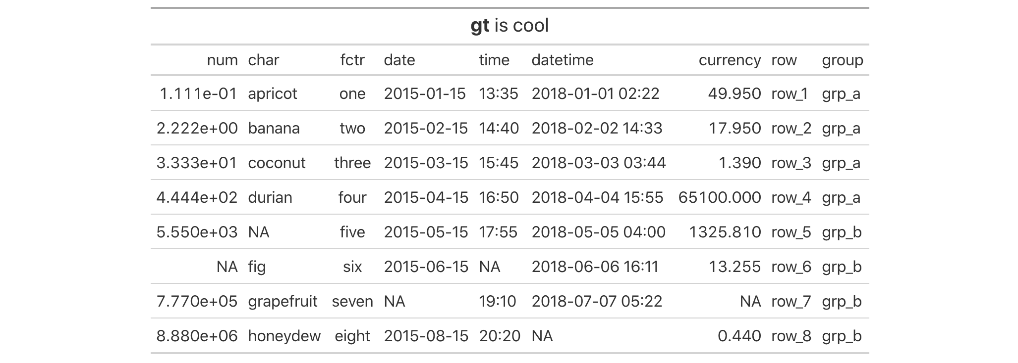
The First Function You Need to Know
Work with Table Components, Add Style
Create or Modify Parts
tab_header() tab_spanner() tab_spanner_delim() tab_row_group() tab_stubhead() tab_footnote() tab_source_note() tab_style() tab_options()
CODE
exibble %>% gt() %>% tab_header(md("**gt** is cool"))
TABLE

Slide 22
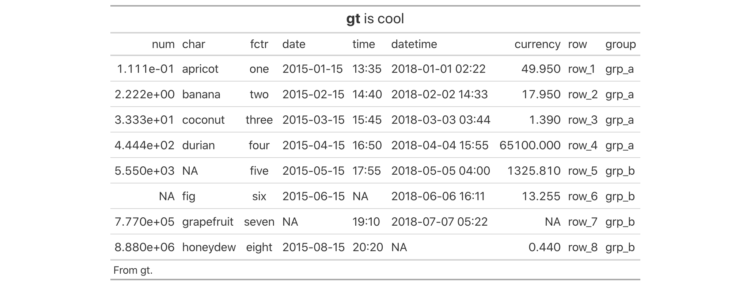
The Formatting Functions
Work with Table Components, Add Style
Create or Modify Parts
tab_header() tab_spanner() tab_spanner_delim() tab_row_group() tab_stubhead() tab_footnote() tab_source_note() tab_style() tab_options()
CODE
exibble %>% gt() %>% tab_header(md("**gt** is cool")) %>% tab_source_note("From gt.")
TABLE

Slide 23
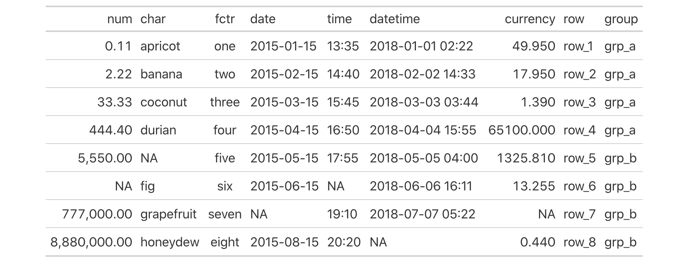
Work with Table Components, Add Style
The Formatting Functions
Format Data
fmt_number() fmt_scientific() fmt_percent() fmt_currency() fmt_date() fmt_time() fmt_datetime() fmt_markdown() fmt_passthrough() fmt_missing() fmt() text_transform() data_color()
CODE
exibble %>% gt() %>% fmt_number(vars(num), decimals = 2)
TABLE

Slide 24
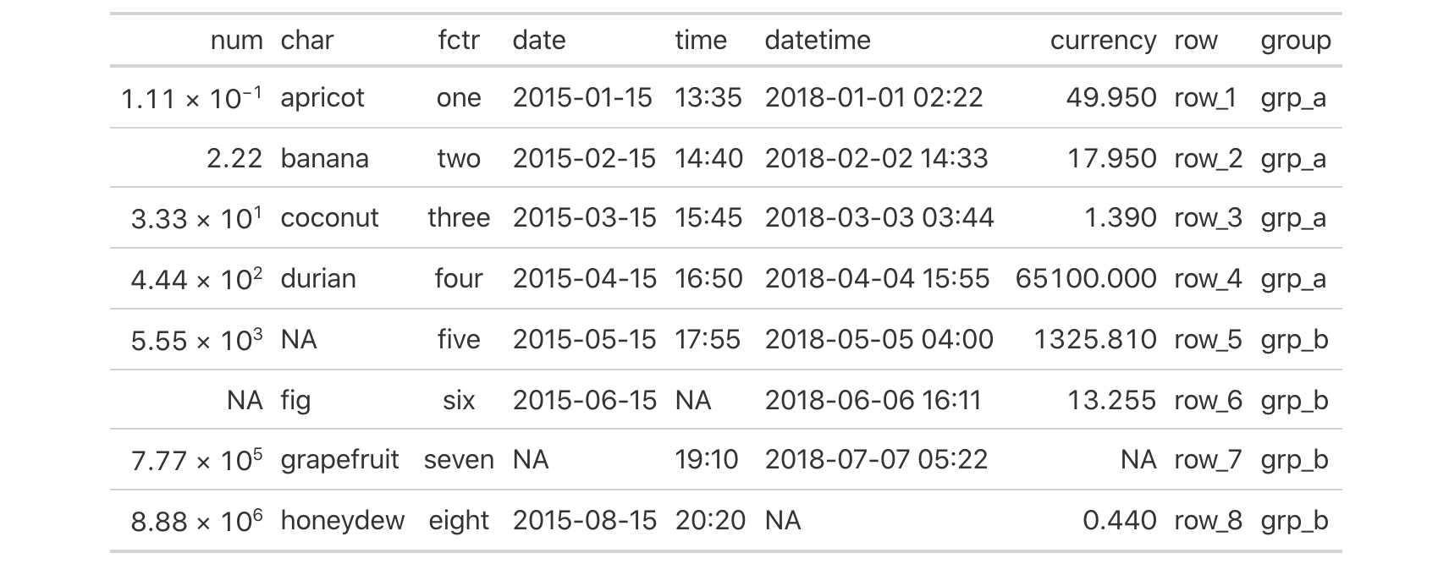
The Formatting Functions
Format Data
fmt_number() fmt_scientific() fmt_percent() fmt_currency() fmt_date() fmt_time() fmt_datetime() fmt_markdown() fmt_passthrough() fmt_missing() fmt() text_transform() data_color()
CODE
)
exibble %>% gt() %>%
fmt_scientific(vars(num)
TABLE

Slide 25
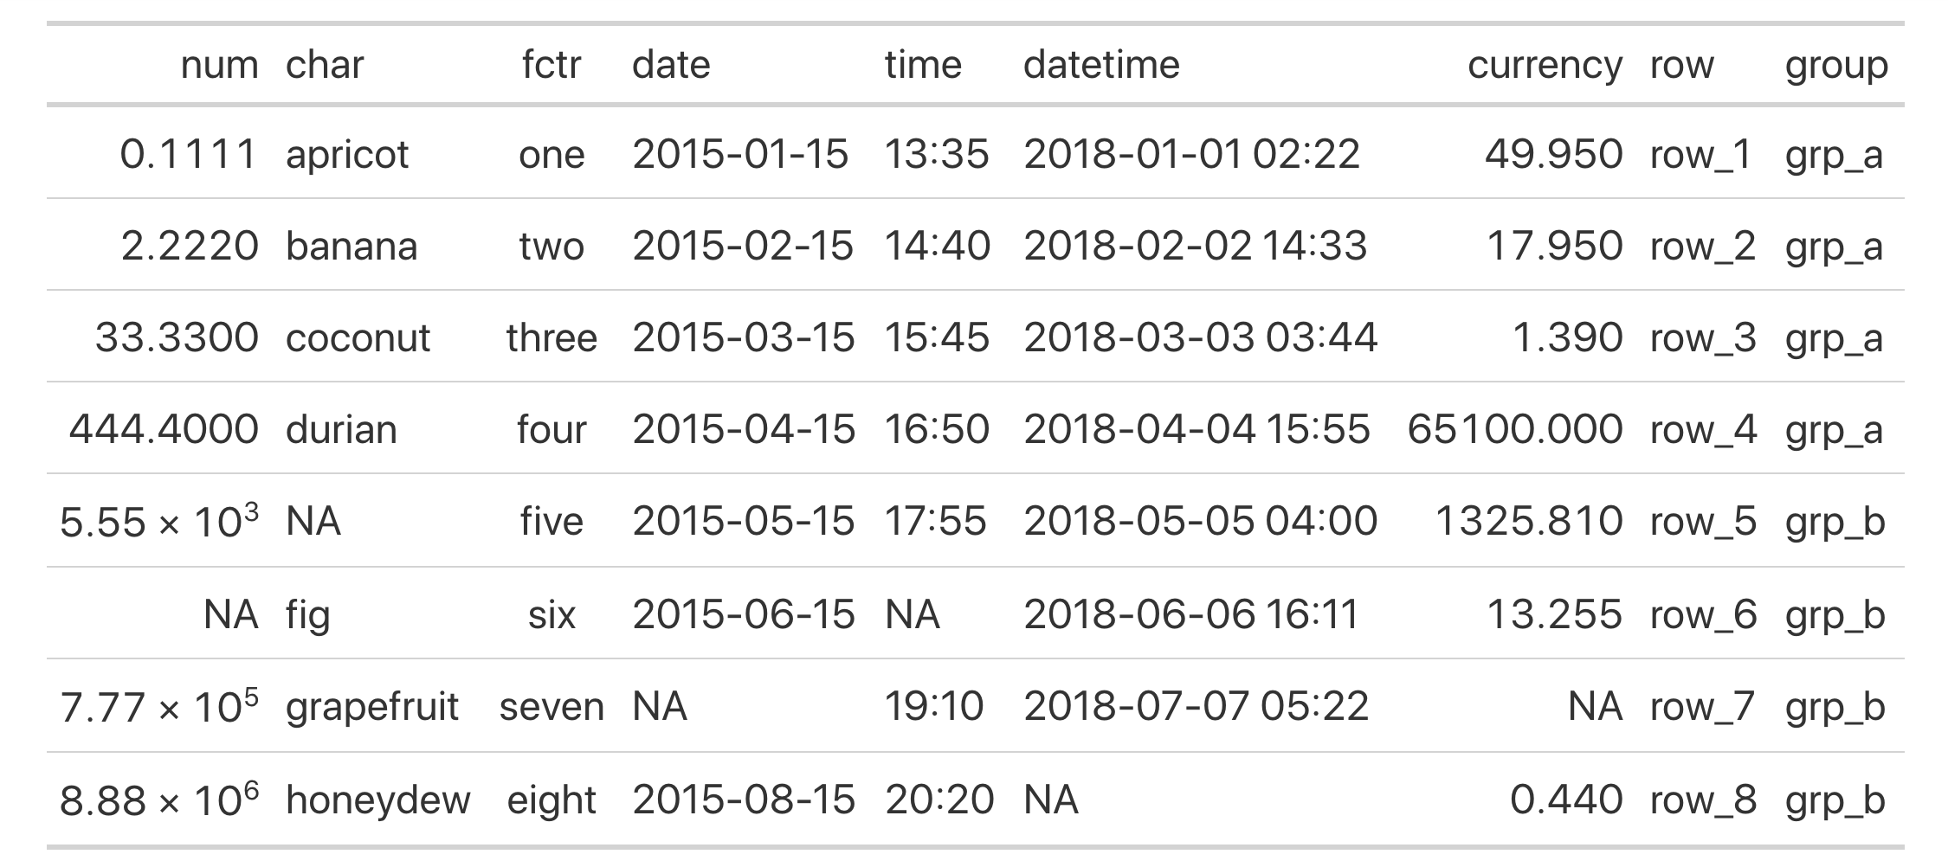
The Formatting Functions
Format Data
fmt_number() fmt_scientific() fmt_percent() fmt_currency() fmt_date() fmt_time() fmt_datetime() fmt_markdown() fmt_passthrough() fmt_missing() fmt() text_transform() data_color()
CODE
exibble %>% gt() %>%
fmt_scientific(vars(num)
)
, rows = num >= 10^3
TABLE

Slide 26

The Formatting Functions
Format Data
fmt_number() fmt_scientific() fmt_percent() fmt_currency() fmt_date() fmt_time() fmt_datetime() fmt_markdown() fmt_passthrough() fmt_missing() fmt() text_transform() data_color()
CODE
try
info_currencies()
exibble %>% gt() %>%
fmt_currency(vars(currency), currency = "EUR")
TABLE

Slide 27
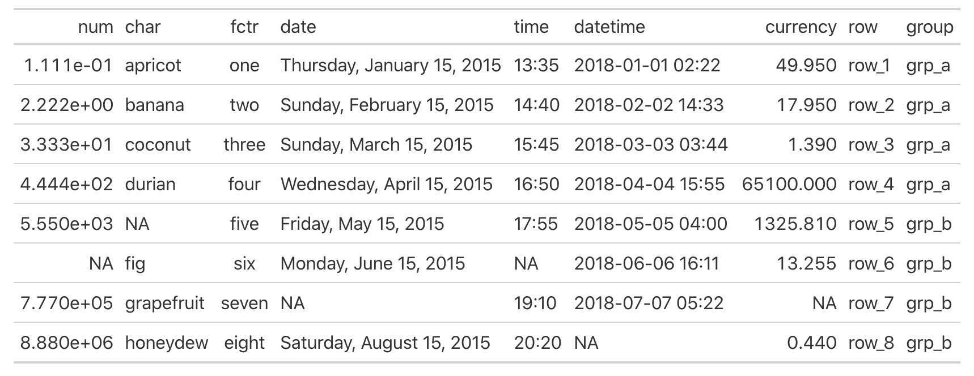
The Formatting Functions
Format Data
fmt_number() fmt_scientific() fmt_percent() fmt_currency() fmt_date() fmt_time() fmt_datetime() fmt_markdown() fmt_passthrough() fmt_missing() fmt() text_transform() data_color()
CODE
try
info_date_style()
exibble %>% gt() %>%
fmt_date(vars(date), date_style = 2)
TABLE

Slide 28
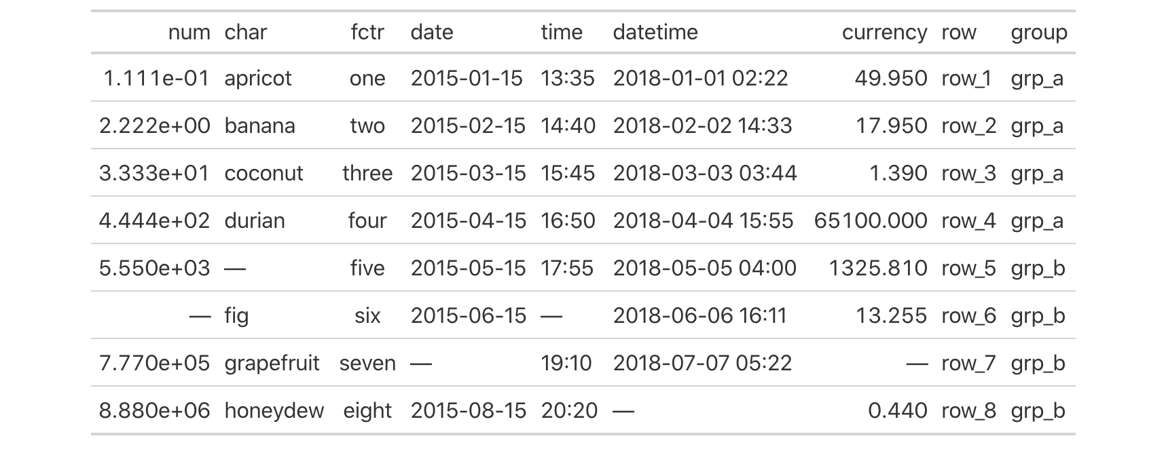
How to Do Modifications on Entire Columns
The Formatting Functions
Format Data
fmt_number() fmt_scientific() fmt_percent() fmt_currency() fmt_date() fmt_time() fmt_datetime() fmt_markdown() fmt_passthrough() fmt_missing() fmt() text_transform() data_color()
CODE
exibble %>% gt() %>% fmt_missing(columns = everything())
TABLE

Slide 29
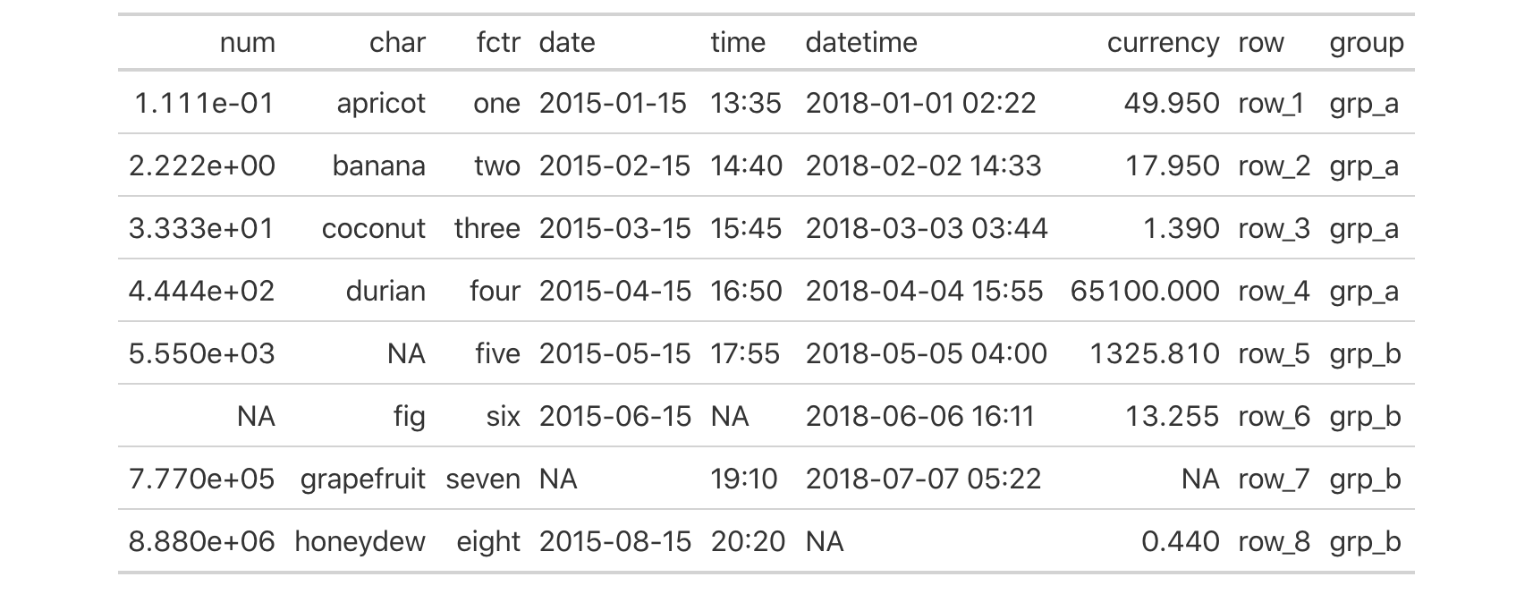
The Formatting Functions
How to Do Modifications on Entire Columns
Modify Columns
cols_align() cols_width() cols_label() cols_move_to_start() cols_move_to_end() cols_move() cols_hide() cols_merge_range() cols_merge_uncert() cols_merge()
CODE
exibble %>% gt() %>%
cols_align(vars(char, fctr), align = "right")
TABLE

Slide 30
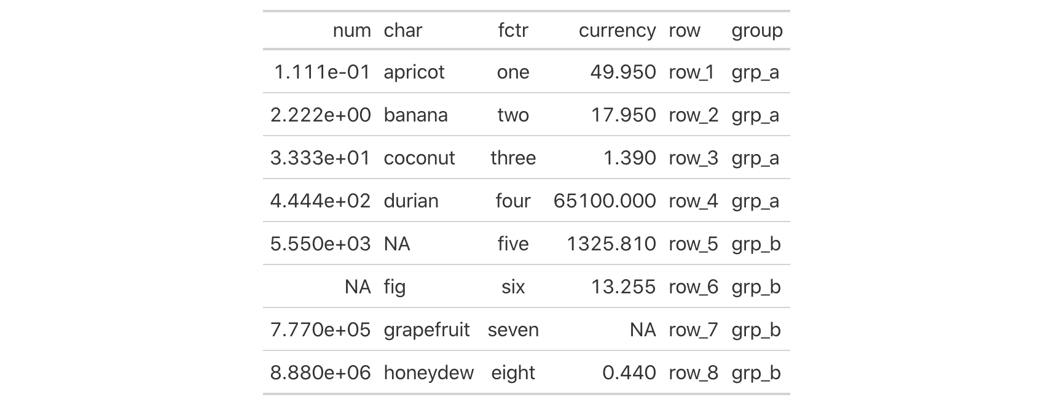
How to Do Modifications on Entire Columns
Modify Columns
cols_align() cols_width() cols_label() cols_move_to_start() cols_move_to_end() cols_move() cols_hide() cols_merge_range() cols_merge_uncert() cols_merge()
CODE
exibble %>% gt() %>% cols_hide(matches("date|time"))
TABLE

Slide 31
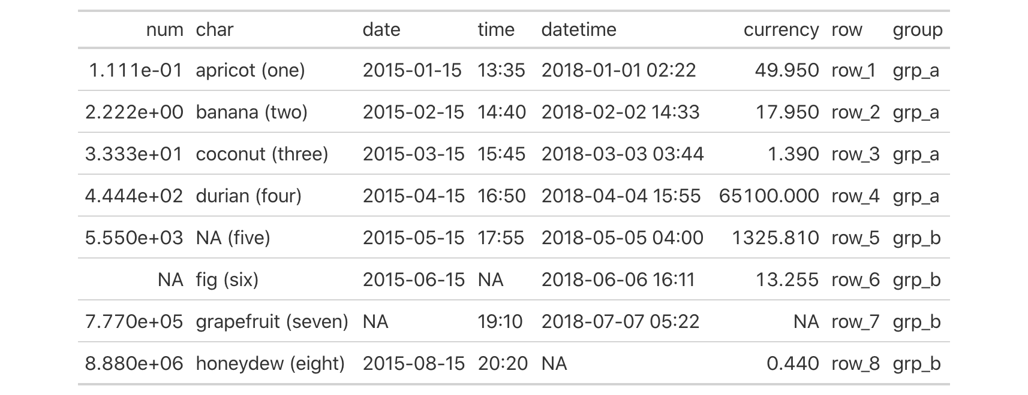
More Functions
How to Do Modifications on Entire Columns
Modify Columns
Create Table
Create or Modify Parts
cols_align() cols_width() cols_label() cols_move_to_start() cols_move_to_end() cols_move() cols_hide() cols_merge_range() cols_merge_uncert() cols_merge()
Format Data
CODE
Modify Columns
exibble %>% gt() %>%
cols_merge(columns = vars(char, fctr), pattern = "{1} ({2})")
Modify Rows
Add Rows
TABLE
Helper Functions
Image Addition Functions
Table Option Functions
Information Functions
Datasets
Shiny Functions
Export Functions

Slide 32

How to Do Modifications on Entire Columns
More Functions
Create Table
Create or Modify Parts
There is a lot of useful information about each function in gt’s Function Reference section
cols_align() cols_width() cols_label() cols_move_to_start() cols_move_to_end() cols_move() cols_hide() cols_merge_range() cols_merge_uncert() cols_merge()
Format Data
Modify Columns
gt.rstudio.com/reference
Modify Rows
Add Rows
You can try out dozens of examples in RStudio Cloud
Helper Functions
Image Addition Functions
Table Option Functions
Information Functions
The link is available in the package README
Datasets
github.com/rstudio/gt
Shiny Functions
Export Functions

Slide 33
Demo

Slide 34
https://github.com/rich-iannone/presentations
rich-iannone
@riannone
rich@rstudio.com

